Slide 1
Do students understand information literacy in the digital era? Role of libraries and librarians to prepare college students for the future
Dr. Vinita Jain
Maharshi Dayanand College of Arts, Sc. & Commerce, Mumbai
vdjain08@gmail.com

Slide 2
Introduction
Information literacy (IL) is a lifelong learning process.
IL helps the learner to become self-directed learner.
IL is defined as a set of abilities that allow individuals to recognize when information is needed and to locate the required information, evaluate it and use it effectively (ALA, 2008)
Libraries and Librarians took up the challenge that every students should become information literate in digital era

Slide 3
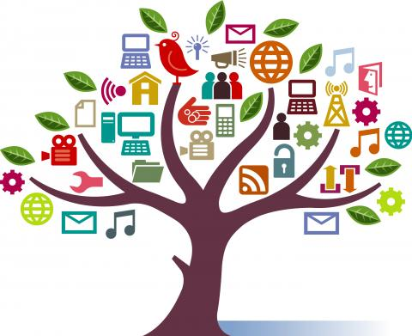
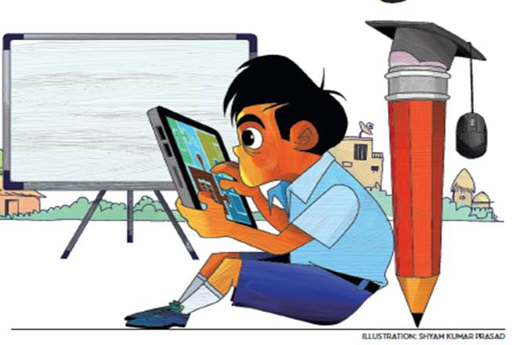
Objectives
Challenges faced by the users while using libraries
To know the level of understanding about IL among users
To find out the digital literacy level among the students
Opportunities to the Libraries
Measures taken by the libraries for better understanding of IL process

Slide 4
Research Method
Category A General Term | Category B Online Features | Category C Research Writing | Category D Online Information Retrieval
OPAC | Email Alerts | Copyright | DELNET
Web-OPAC | Boolean Operators | Plagiarism | NLIST
Index | Online Journals | Google scholar | MOOC
Open access | E books | Shodhganga | Swayam
News Clippings | QR Code | Peer review Journal | NDLI
Digital Library | Website/Library home page | References | IR
Keywords | Online feedback | Bibliography | Consortium
 |  | Citations | Database
 |  | Full Text
 |  | Impact factor
Notes:
Every year we need to take IL program during the month of June-July

Slide 5
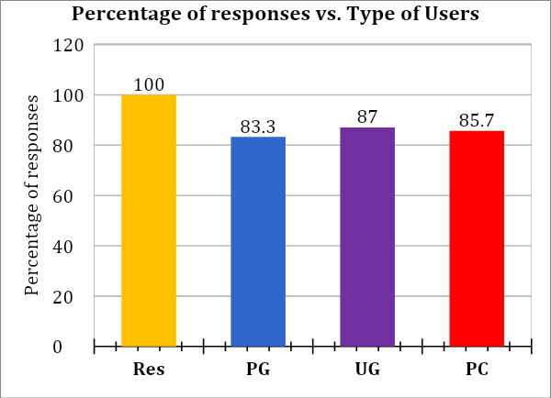
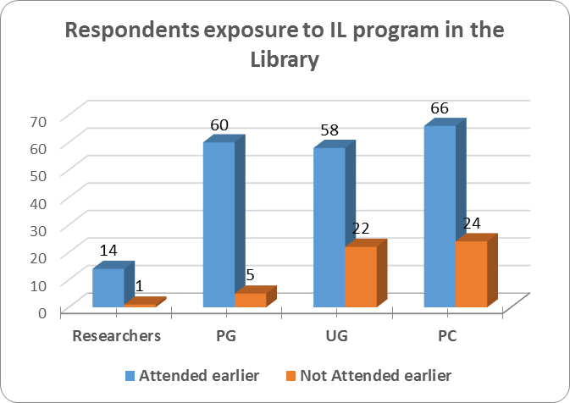

Slide 6
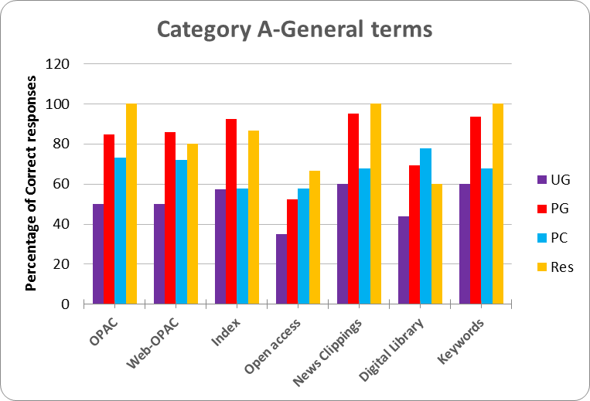
Category A | UG | PG | PC | Res
Total Respondents | 80 | 65 | 90 | 15
OPAC | 40(50%) | 55(84.6%) | 66(73.3%) | 15(100%)
Web-OPAC | 40(50%) | 56(86.1%) | 65(72.2%) | 12(80%)
Index | 46(57.5%) | 60(92.3%) | 52(57.7%) | 13(86.6%)
Open access | 28(35%) | 34(52.3%) | 52(57.7%) | 10(66.6%)
News Clippings | 48(60%) | 62(95.3%) | 61(67.7%) | 15(100%)
Digital Library | 35(43.7%) | 45(69.2%) | 70(77.7%) | 9(60%)
Keywords | 48(60%) | 61(93.8%) | 61(67.7%) | 15(100%)

Slide 9
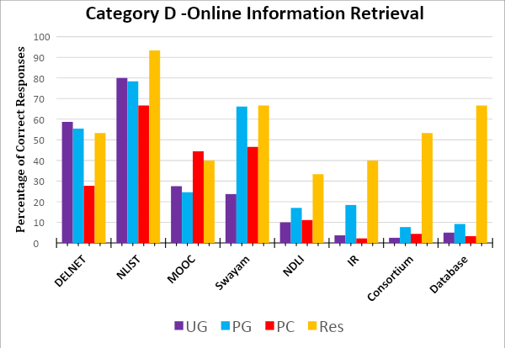
Category D | UG | PG | PC | Res
Total Respondents | 80 | 65 | 90 | 15
DELNET | 58.7 | 55.4 | 27.7 | 53.3
NLIST | 80 | 78.4 | 66.6 | 93.3
MOOC | 27.5 | 24.6 | 44.4 | 40
Swayam | 23.7 | 66.1 | 46.6 | 66.6
NDLI | 10 | 17 | 11.1 | 33.3
IR | 3.7 | 18.4 | 2.2 | 40
Consortium | 2.5 | 7.7 | 4.4 | 53.3
Database | 5 | 9.2 | 3.3 | 66.6

Slide 11
Recommendations
For Users | For Librarians | For HEIs
Regular Feedback is Required | Coordination with faculty members | IL should include in the curriculum
IL can be arranged as per type of users, It can be flexible as per need | Prepare a glossary of important terminology | Include choice based credit courses to understand technology
6-10 hours of training is required to use the library resources optimum | Self Analysis / Self Motivation is a must | Train the teachers to focus on digital technology
Micro level instruction program arranged for research scholars | Design IL program for internal staff | Induction program for new recruiters
Social media can be used to update the users | Continuous professional development | Awareness about Plagiarism, Citations & Copyright issues

Slide 12
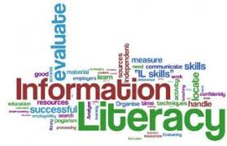
Conclusion
Make IL program a regular activity in HEIs.
Keeping up to date is a real challenge to librarians
College students are not really keen to use library, however their perception about library is changed after attending IL program and start using the library facility.
Students are very happy to use online features available through their smartphones, but again usage are not satisfactory.
Digital resources goes unutilized if users are unaware of how to use it
Understanding of digital literacy level is more in researchers and post graduate students in compare to under graduate and professional course students.

Slide 13
References:
ALA. (2008). Presidential Committee on Information Literacy: Final report. Retrieved 5 11, 2019, from ala.org: ttp://www.ala.org/acrl/publications/whitepapers/presidential
Islam, M. A., & Tsuji, K. (2010). Assessing information literacy competency of Information Science and Library Management graduate students of Dhaka University. IFLA journal, 36(4),300-316.
Jacklin, M., & Et al. (2008). "Innovations in Practice: Drop in clinics for environment studies student’s partnership”. The Canadian Journal of Library & Information Practice & Research, 3(2), 1-7. Retrieved 05 10, 2019
McDevit, T., & Jen, J. (2013). We are all in this together stress reduction and team building activities for modern library organization. Codex : The Journal of the Louisiana chapter of the ACRL, 2(3), 78-99.
Watson, S., & Et al. (2013). Revising the One-shot through lesson study, collaborating with writing faculty to rebuild a library instruction session. College & Research Libraries, 74(4), 381-398. doi:10.5860/crl12-255
Schaub, G., Cadena, C., & Bravender, P. (2017). The Language of Information Literacy: Do students understand? College & Research Libraries, 283-296.
Swapna, G., and S. G. Biradar. 2017. "Information Literacy Model for Higher Education Institution in India." International Journal of Digital Library Services (IJODLS) (Geetanjali Research Publications) 7 (3): 31-48. Accessed 8 2, 2019. www.ijodla.in.
Thomas, D. (2003, Jan). Web Manager's Handbook, Special Issue. Library Technology Reports, 39(1), 50. Retrieved 06 10, 2019, from https://journals.ala.org/ltr/issue/view/154

Slide 14
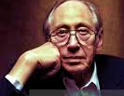
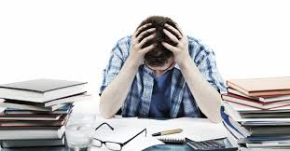
“The Illiterate of the 21st Century will not be those who cannot read and write, but those who cannot learn, unlearn and relearn”
Alvin Toffler
Thank You !!!

